Slide 1
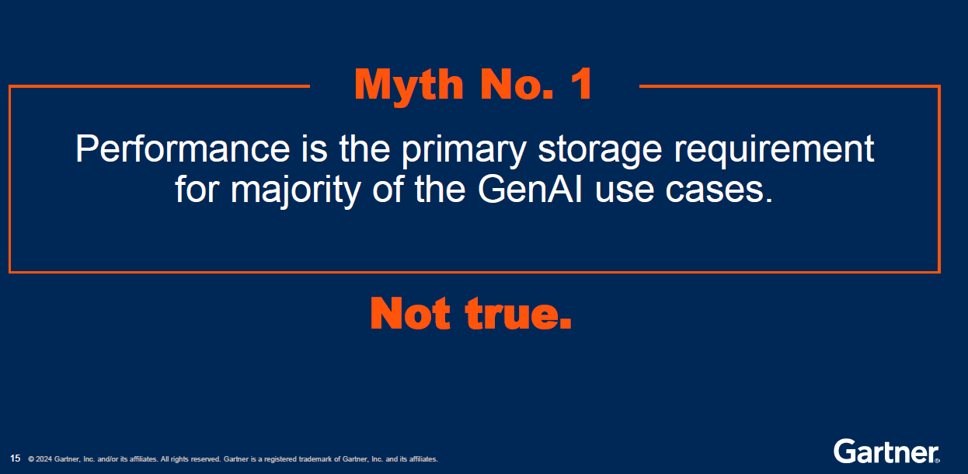
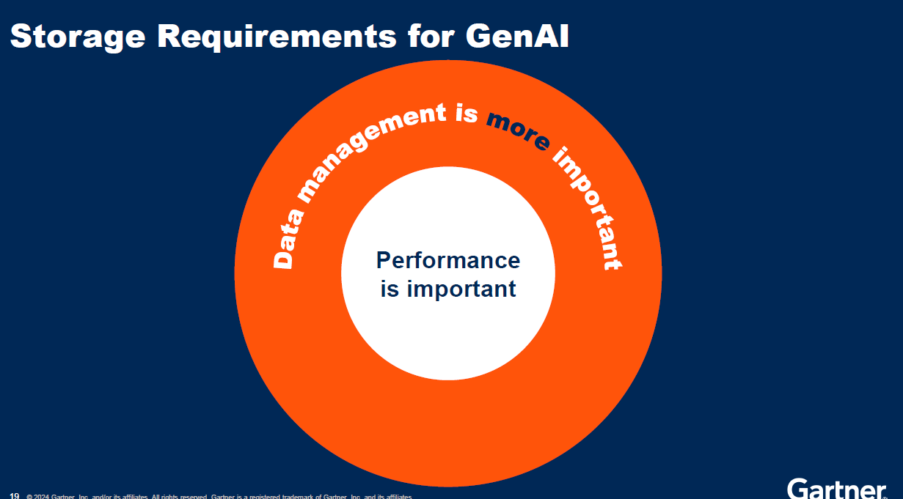
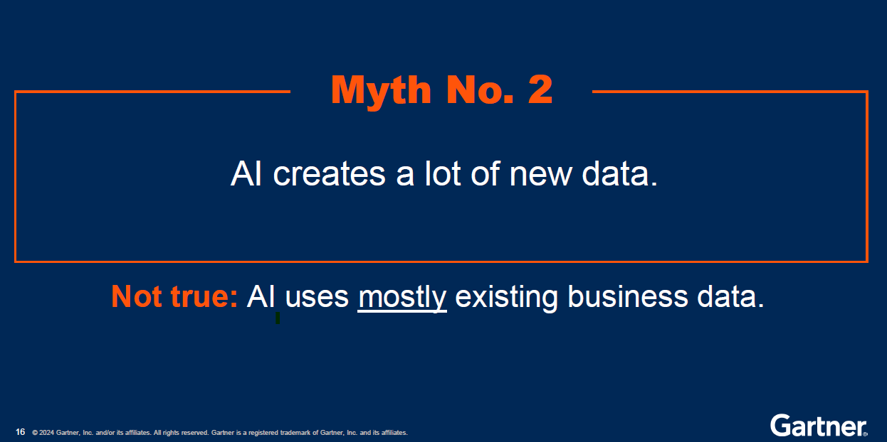
GenAI needs data management more than faster storage

Slide 2
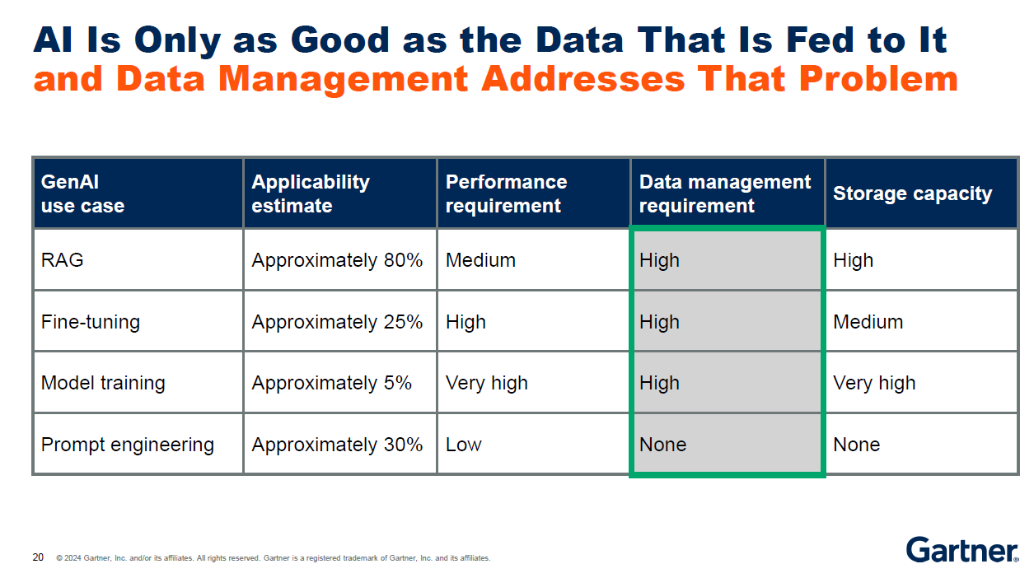

Slide 3

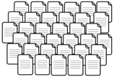








Komprise systematically finds, feeds data to rag: Azure ai demo
Search
Cull & Feed RAG
Across billions of files.
Data Sources: Any File, Object data stores
Define custom query in Komprise
to find Benefits documents across all sites
Azure augments OpenAI RAG w curated docs fed by Komprise
Komprise moves only new results
to Azure OpenAI
Audit log for Data Governance
As new data arrives, the workflow automatically runs again.

Slide 4
Example: creating azure OpenAI chatbot to augment w/ latest corporate data
Premium Health Plan covers additional benefits depending on your company
What is the difference between the Standard and Premium Health Plan in California?
OpenAI response without corporate data
Starting Jan 1, 2024, employees in California have coverage for acupuncture in the Premium but not in the Standard plan
OpenAI response after Komprise feeds corporate benefits documents to Copilot to augment the prompt without leaking data to the base model

Slide 5
SDW: Enrich data for OpenAI prompt grounding
Datastore indexer
Search index
Azure blob container
Run curated queries on Komprise GFI
Copy matching files to Azure blob container
Datastore indexer
Known sources
Komprise
Global File Index

Slide 6
Model inferencing favors the data estate
10% vs 90%:
Inferencing will be 90% of TAM
Model Training
Highly specialized
Used by few researchers/Data scientists
Compute-centric
Model Inferencing & Use
More generalized
Used by most users
Runs where the data is
Needs easy-to-use tools

Slide 7



How many of you get the “Ai-Roll” from your Storage Team?
Is this really a priority?
How is AI relevant to us?

Slide 8
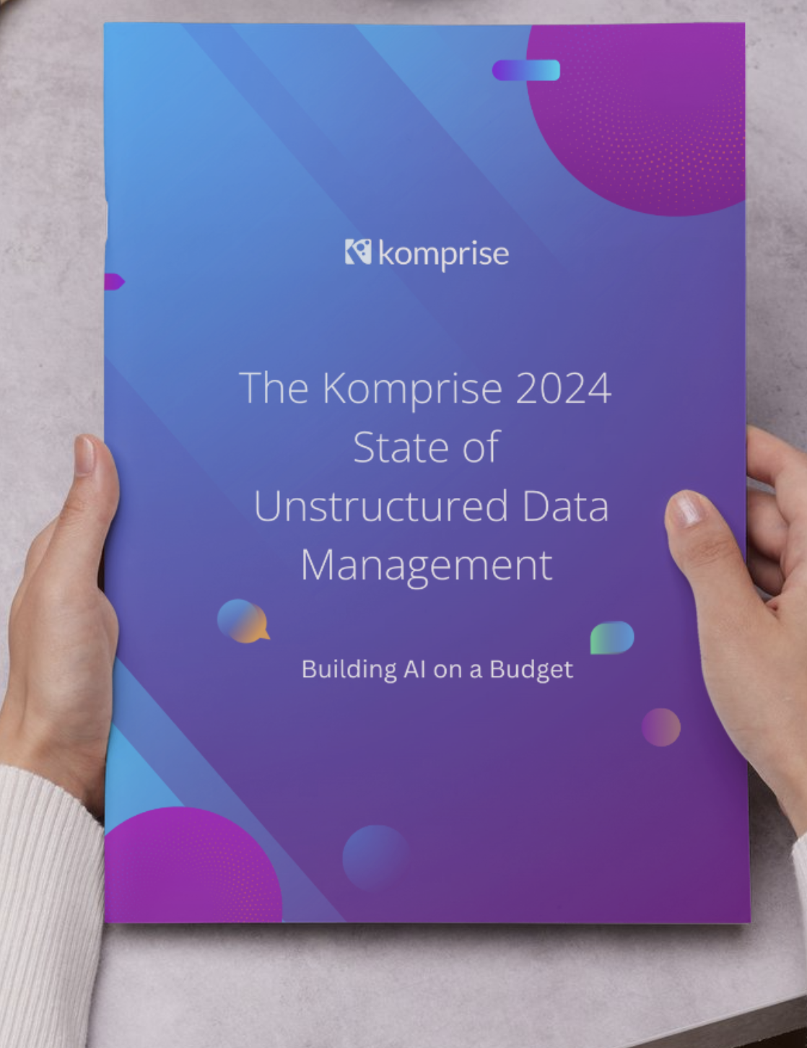
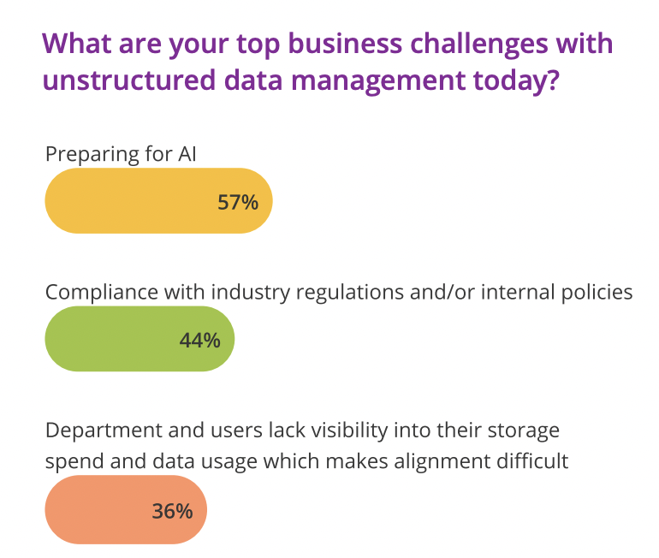
Preparing Data for AI
The top Unstructured Data Business Challenge

Slide 9
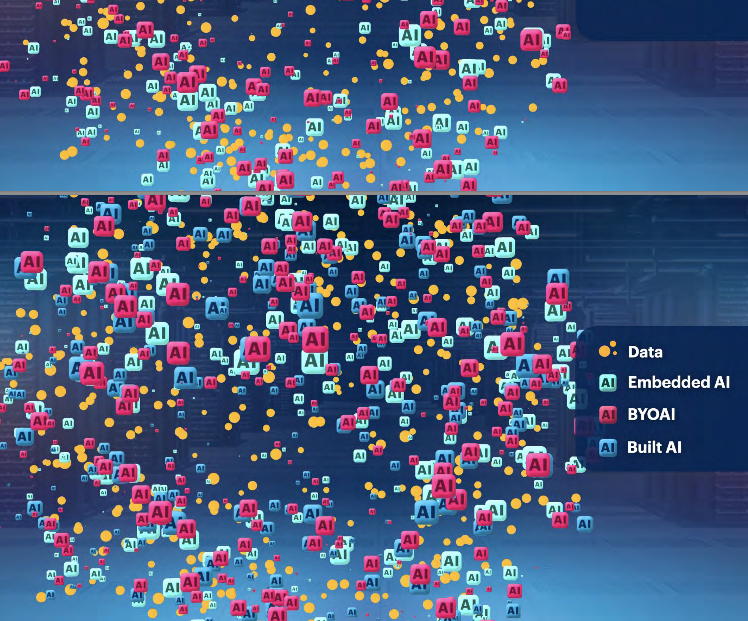

AI Needs Data…and Most of it is Unstructured!

Slide 10



Why Your Storage Team Should Care About AI?
Search
Move
Govern, Secure
Help users classify, find, tag the right data
Automate AI data ingestion, migration, etc.
Detect sensitive data, set policies, reduce attack surface
Notes:
Search – how do I find the right data?
Move – how am I going to get it? Systematic, could be billions of files
3. Governance and Security

Slide 11
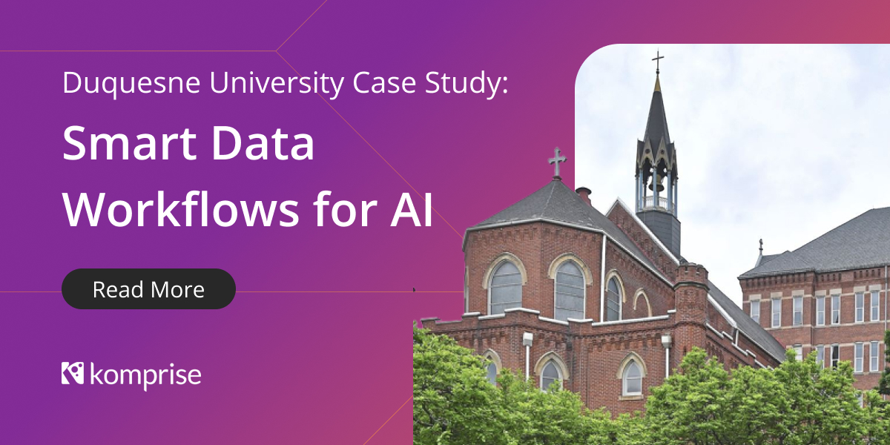

Duquesne Results: 100x improvement in searches
Search
Run AI
Tag
100x reduction in time and effort
No manual search, inspection, copying of millions of files
3M files -> 10k images of interest -> Tagged 9 files with picture of JFK
Time taken: 1hr 53min -- Manually this could take half the summer
Repeatable – next search will take only minutes

